Slide 1

Introduction to Kotlin
Tobias Schürg - 25.09.2018

Slide 2




Kotlin Intro
The new fancy, opensource programming language
Runs on the Java Virtual Machine
Can be compiled to JavaScript as well
Statically typed
Interoperable with Java code
Developed by JetBrains (IntelliJ)
First appeared 2011 (already developed for a year)
Kotlin v1.0 was released on February 15, 2016
Goals:
compile as quickly as Java
more compact
more concise
easier to read

Slide 3
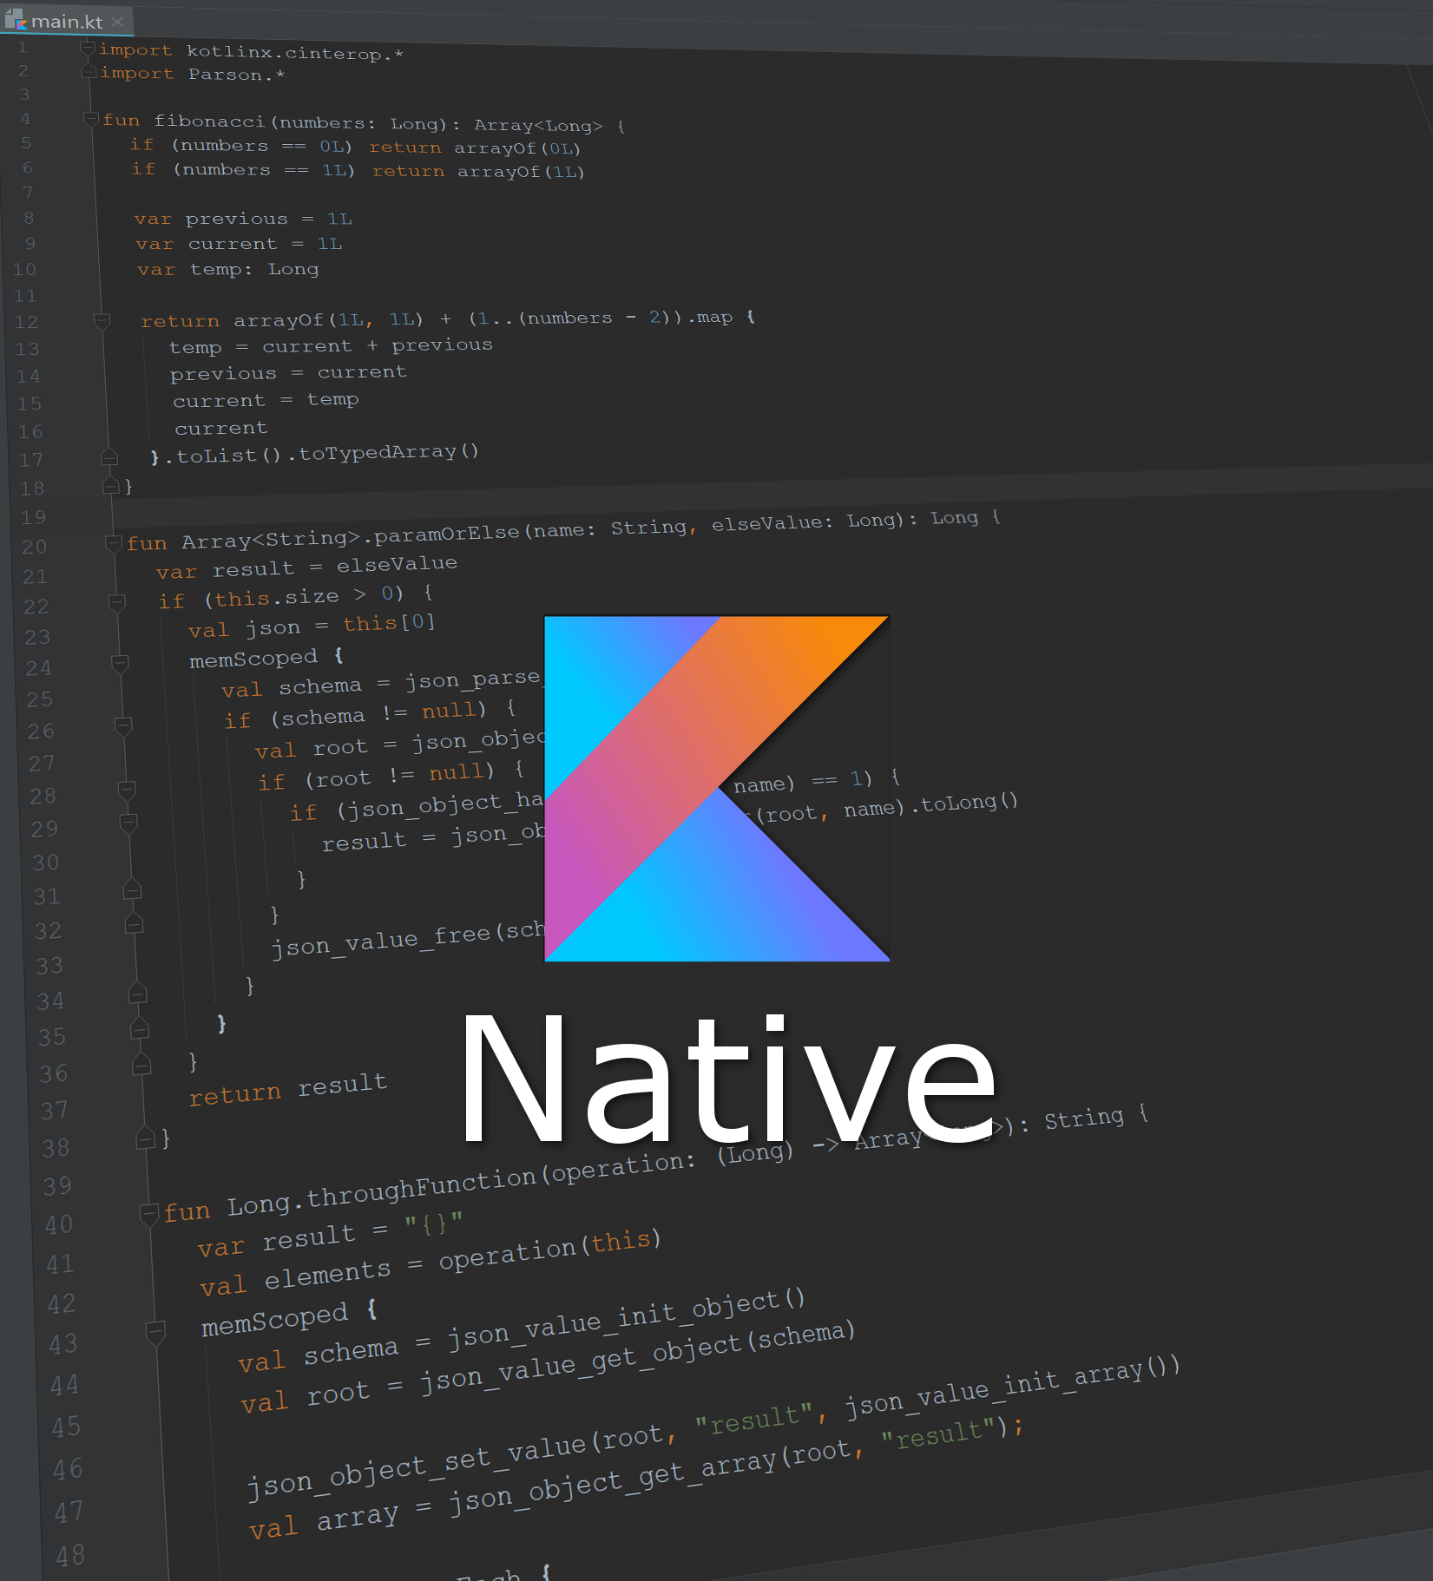
Kotlin Native
Compile Kotlin to native binaries
Windows (x86_64 only at the moment)
Linux (x86_64, arm32, MIPS, MIPS little endian)
MacOS (x86_64)
iOS (arm32 and arm64)
Android (arm32 and arm64)
WebAssembly (wasm32 only)
https://kotlinlang.org/docs/reference/native-overview.html

Slide 4
Kotlin - Basics

Slide 5
Defining Variables
Control Flow
Loops and ranges
Smart casts
Interoperability with Java

Slide 6
Null Safety
Avoiding the billion dollar mistake
NPE will only occur if
Explicitely thrown
The `!!`-operator is used
External Java code caused it
Safe calls
Elvis Operator
!! Operator
b?.length bob?.department?.head?.name
val l = b?.length ?: -1
val l = b!!.length

Slide 7
Classes
Instance creation without “new” keyword
Data Classes
Object Classes (Singletons)
Sealed Classes
Default Values
Companion Objects

Slide 8
There is a lot of fun in Kotlin
Default arguments
Named arguments
Single expression functions
Inline functions
Infix functions
Extension functions
Notes:
Named arguments: assert euqals
Ext functions -> Expressity: no need to extend standard classes

Slide 9
Higher-Order Functions and Lambdas
Functions which can take one or more functions as arguments
“Alternative to interfaces and BiFunctions”
Implicit name of single parameter: it
fun <T, R> List<T>.map(transform: (T) -> R): List<R> {
val result = arrayListOf<R>()
for (item in this) result.add(transform(item))
return result
}

Slide 10
Kotlin – Advanced

Slide 11
Coroutines
Until now: callbacks, async tasks / threads, rx
Motivation: async / await
compile "org.jetbrains.kotlinx:kotlinx-coroutines-core:0.19.2"
kotlin { experimental { coroutines 'enable' } }

Slide 12
Resources

Slide 13
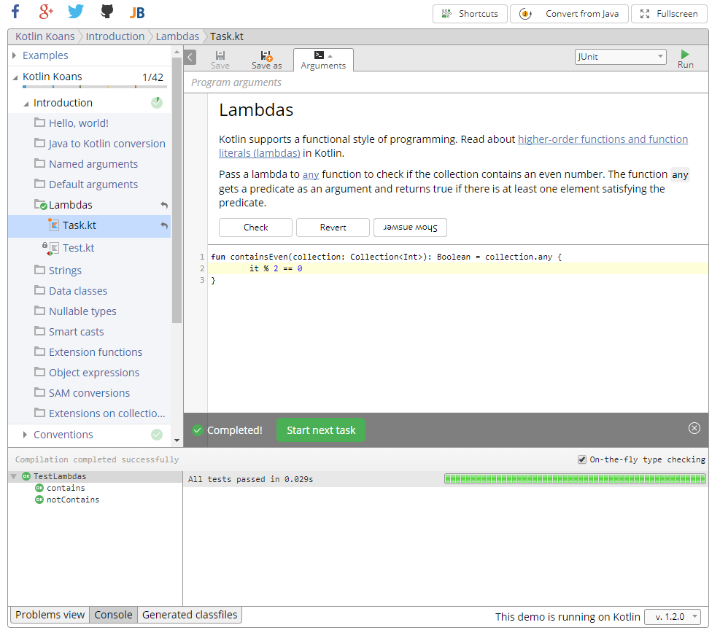
Kotlin Koans
https://try.kotlinlang.org

Slide 14
Useful Resources
Starting:
Kotlin refernce: https://kotlinlang.org/docs/reference/
Kotlin Koans: Onlince: https://try.kotlinlang.org GitHub:https://github.com/Kotlin/kotlin-koans
Introduction to Kotlin (Google Developer Days ‘17): https://www.youtube.com/watch?v=YbF8Q8LxAJs
Coroutines
https://kotlinlang.org/docs/reference/coroutines.html
Svetlana Isakova - Kotlin coroutines (44 min) https://www.youtube.com/watch?v=nugOMl29K3k
Additional
Danny Preussler - The power of Kotlin for your tests (40 min): https://www.youtube.com/watch?v=V3e9KRfGqsQ

